Slide 1
The Economic Outlook
Dr Martin Weale
External MPC Member
St Catharine’s College Cambridge
22nd October 2014

Slide 2

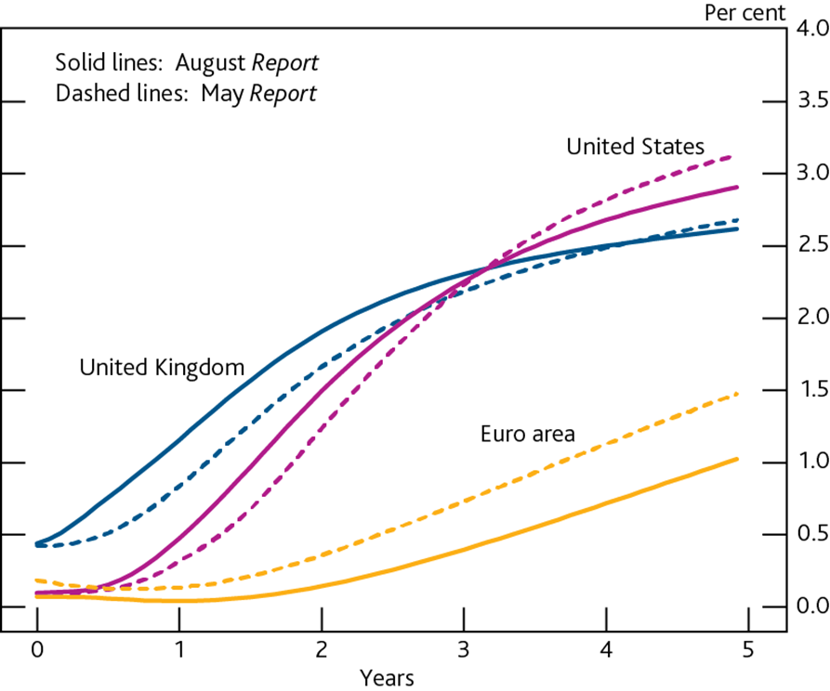
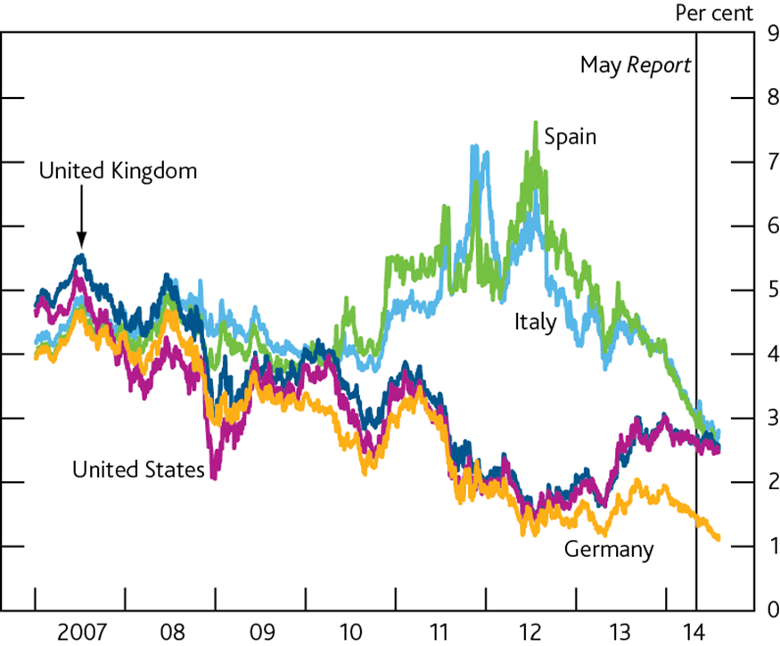
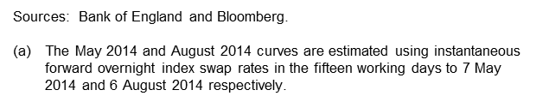

Financial markets

Slide 3


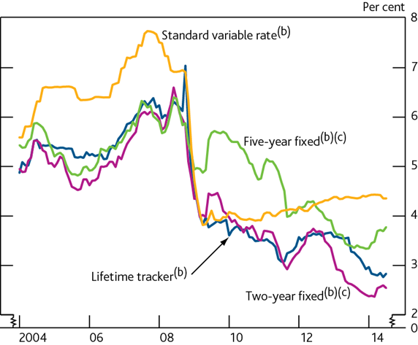
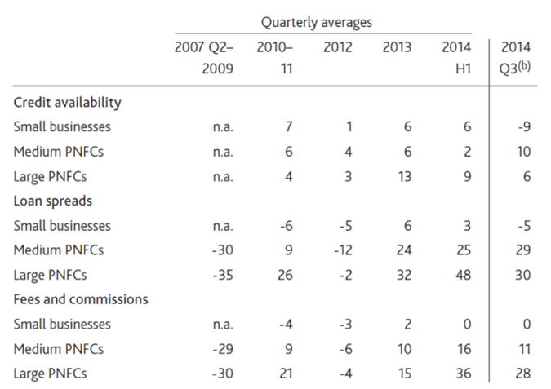
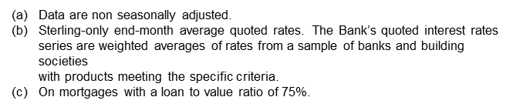
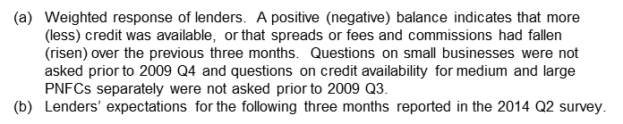
Lending to households & PNFCs

Slide 4


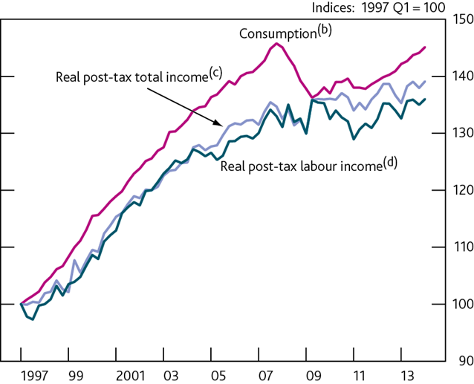
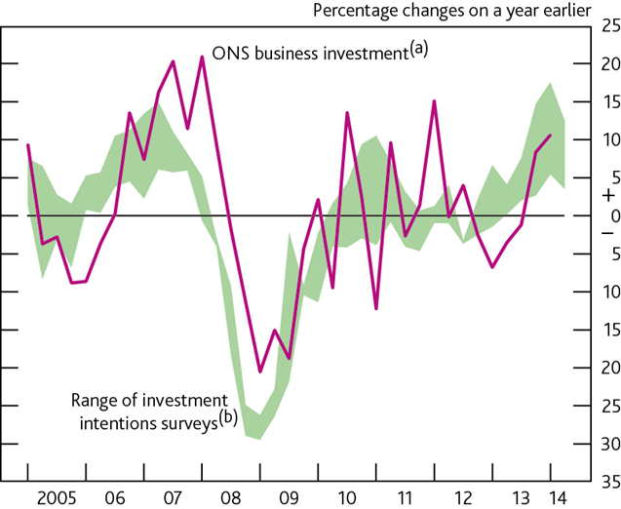
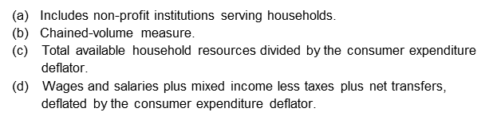
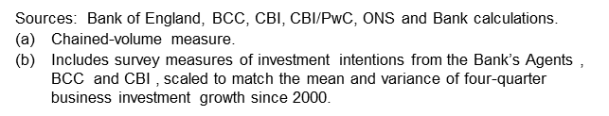
Demand & Output

Slide 5

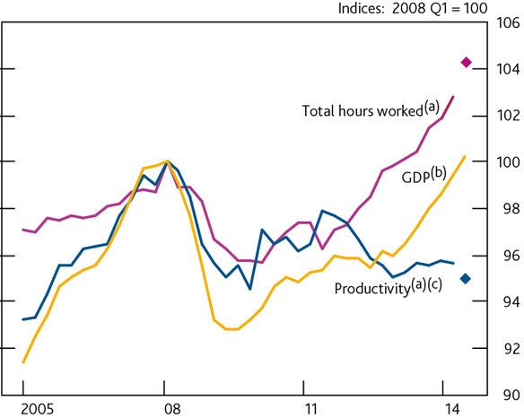
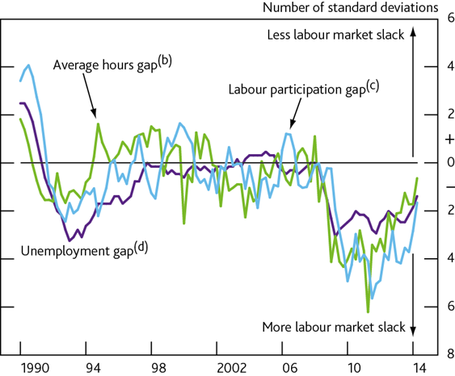
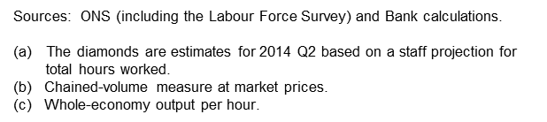
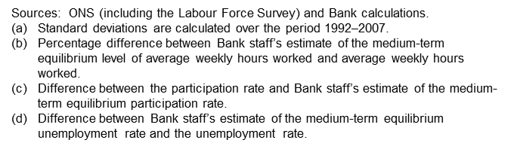
Supply & Productivity

Slide 6


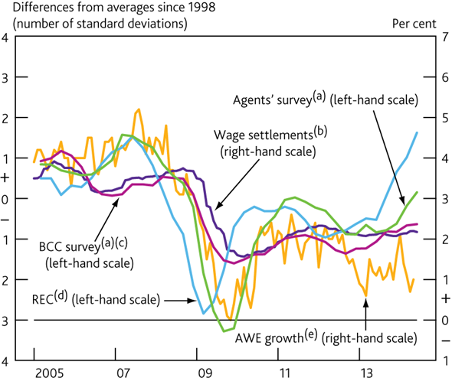
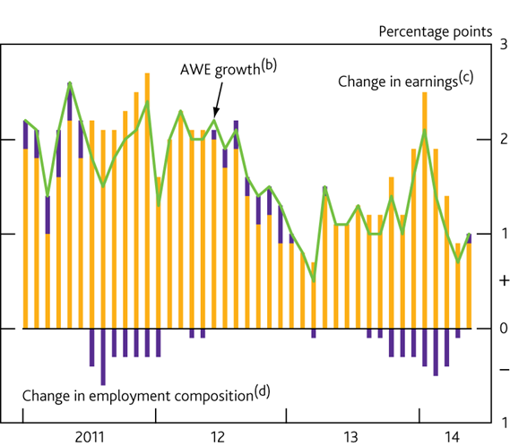
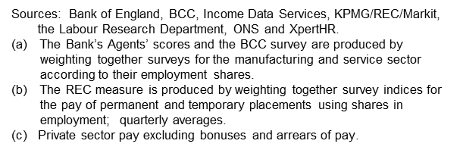
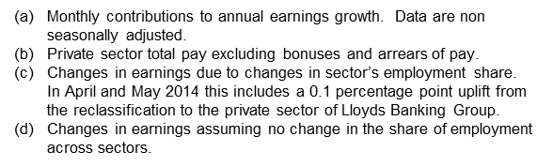
Costs and Prices

Slide 7
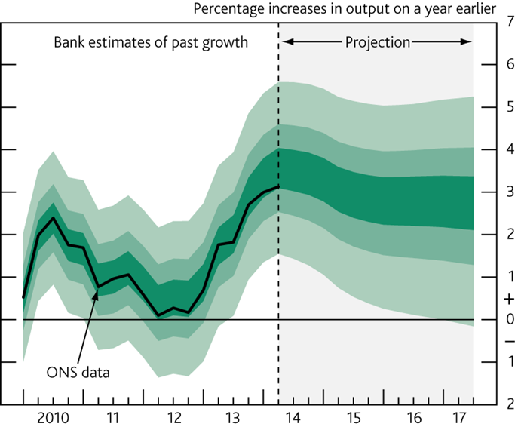
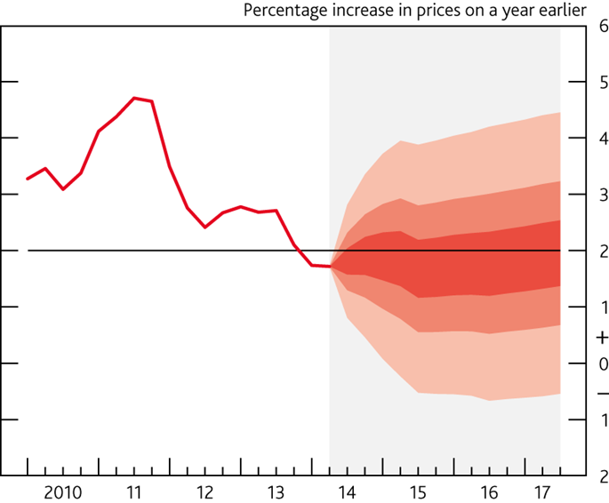


GDP and inflation forecasts
Chart 10 GDP projection based on market interest rate expectations and £375 billion purchased assets
Chart 11 CPI inflation projection based on market interest rate expectations and £375 billion purchased assets

Slide 8
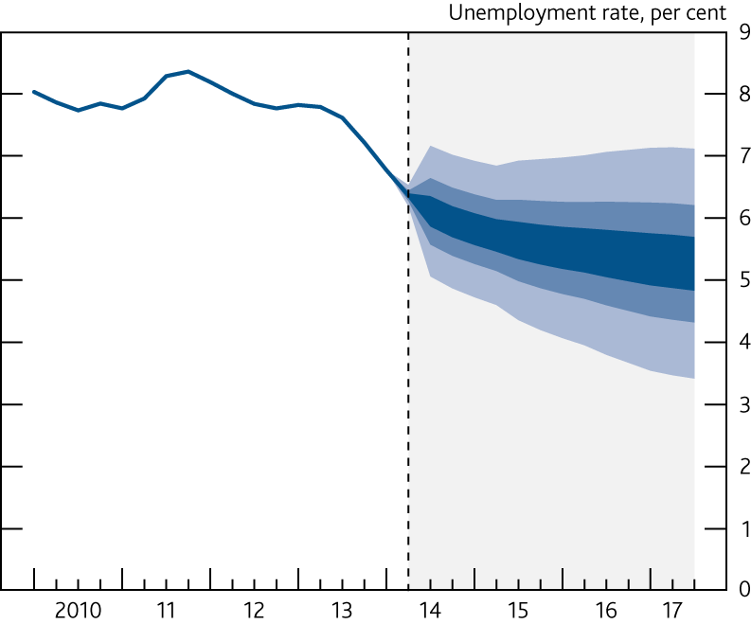
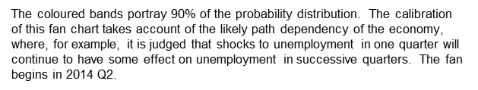
Unemployment rate
Chart 12 Unemployment projection based on
market interest rate expectations and £375
billion purchased assets
External MPC Member

Slide 9
Movements over the last three months
The Current Economic Position
Chart 13: Share price movements over the last three months, indexed to 01/08/2014
External MPC Member

Slide 10
Expected Future Spot Rates
The Current Economic Position
Chart 14: UK future spot rates 5 years ahead
Chart 15: US future spot rates 5 years ahead
External MPC Member

Slide 11
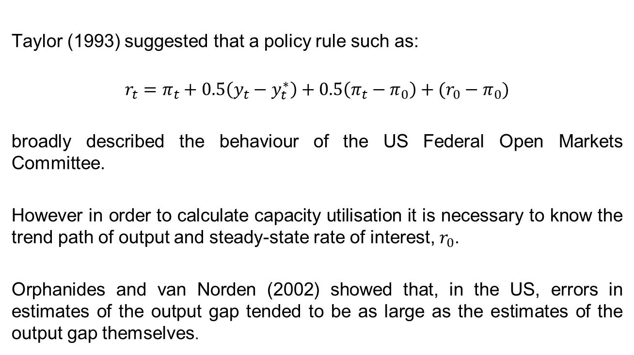
Policy-Making when Output and Inflation Matter
Taylor (1993) suggested that a policy rule such as:
$$r_{t}=π_{t}+0.5\left(y_{t}−y_{t}^{∗}\right)+0.5\left(π_{t}−π_{0}\right)+(r_{0}−π_{0})$$
broadly described the behaviour of the US Federal Open Markets Committee.
However in order to calculate capacity utilisation it is necessary to know the trend path of output and steady-state rate of interest, $r_{0}$.
Orphanides and van Norden (2002) showed that, in the US, errors in estimates of the output gap tended to be as large as the estimates of the output gap themselves.
External MPC Member

Slide 12
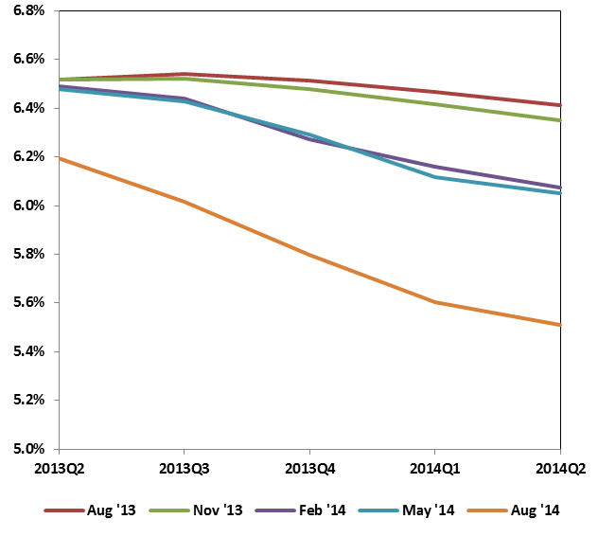
Sources of Uncertainty
Chart 16: Revisions To The Medium-term Equilibrium Unemployment Rate Since August 2013
Chart 17: Five year on Five-year Forward Interest Rates (% p.a.)

Slide 13
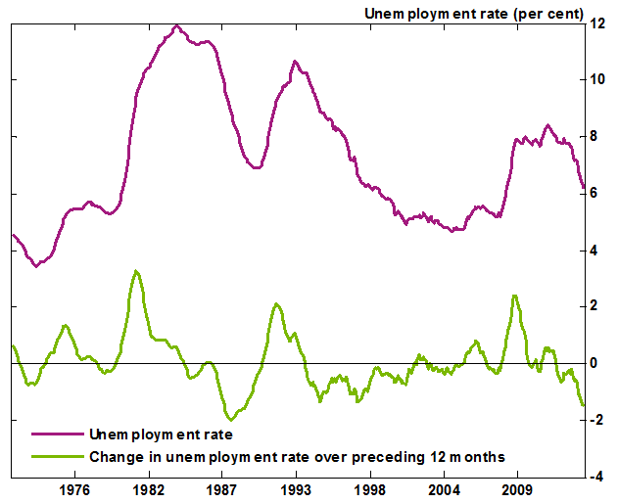
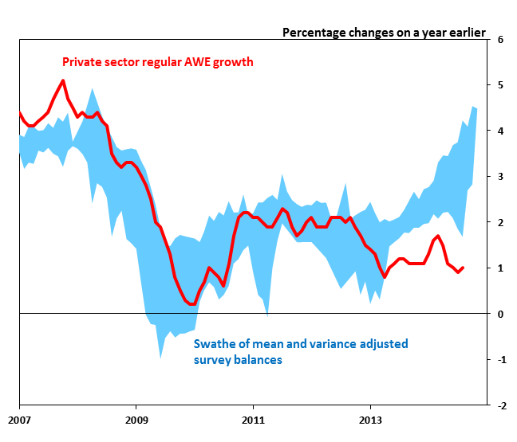
Policy Influences in Practice
Chart 18: The Unemployment Rate and its Change over 12 Months
Chart 19: Average Weekly Earnings and Survey Indicators of Pay Pressures
External MPC Member

